Slide 1

DAR ES SALAAM INSTITUTE OF TECHNOLOGY
DEPARTMENT OF ELECTRICAL ENGINEERING
NTA LEVEL 8
PROJECT TITLE: DESIGN AND IMPLEMENTATION OF INTELLIGENT AND EFFICIENT TOMATO SORTING MACHINE WITH PRECISION AT ULANGA FOOD PANTRY
PROJECT TYPE: PROBLEM SOLVING
NAME OF STUDENT: MORICE KURUSANGA REGISTRATION NO: 2103303219562
CLASS: BENG21-EE
ACADEMIC YEAR: 2024/2025

Slide 2
PROBLEM STATEMENT:
The manual sorting of tomatoes in agricultural is a labor-intensive, time-consuming and error prone process.This often leads to inefficient, reduce productivity and increased operational costs. Also human error in sorting can affect the overall quality of the end product, impacting customer satisfaction and market value.
To address these challenges, there is a need of an intelligent, automated sorting machine that can efficiently sort tomatoes based on ripeness and its quality. This system will improve sorting speed and reduce labor dependency.

Slide 3
OBJECTIVES
Main Objective
To design and implement of an intelligent and efficient tomato sorting machine with precision at Ulanga food pantry.
Specific objectives
To design an intelligent tomato sorting machine based on machine learning.
To simulate the assemble circuit.
To build and test the prototype.

Slide 4
SIGNIFICANCE OF THE PROJECT
The proposed system will reduce cost and labor dependency
The proposed system will enhance time management
The proposed system will ensure consistent quality of sorted tomatoes
The proposed system will promote technological advancement in agriculture specifically tomato farming
The proposed system will enable long and efficient preservation of tomatoes

Slide 5
METHODOLOGY
Literature review.
Data collection.
Data analysis.
Design of the proposed system.
Simulation of the proposed system.
Circuit simulation.
Prototype building.
Prototype testing.

Slide 6
LITERATURE REVIEW
Existing system
The existing system relies on manual sorting of harvested tomatoes.
Ripe tomatoes are designated for immediate use.
Unripe tomatoes are sent to the pantry for storage, while rotten tomatoes are identified and discarded into the dumped section.
Disadvantage of the existing system
Time consuming, labor-intensive, prone to error and often result in inconsistencies and delays.

Slide 7
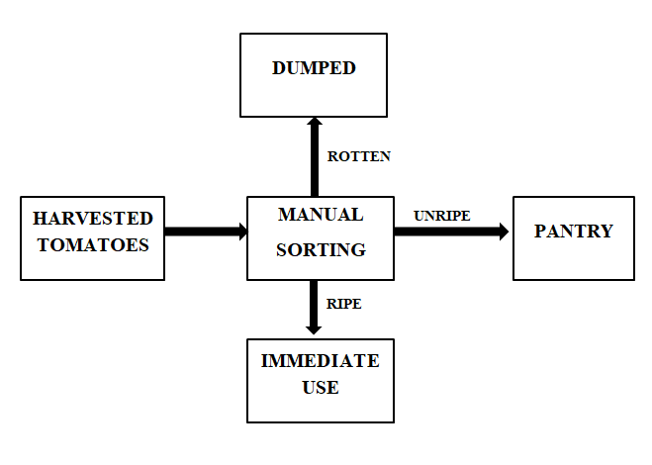
BLOCK DIAGRAM OF EXISTING SYSTEM

Slide 8
LITERATURE REVIEW
Proposed system
Harvested tomatoes are loaded into the hopper, which serves as the input unit.
The color sensor then detects their ripeness or defects.
The data is sent to the MCU(Microcontroller Unit), which processes the information and control the motor drive and robotic arm.
The robotic arm picks up the tomatoes and places them into the appropriate container: ripe, unripe, or rotten.
The power supply provide energy to all the components.
This system ensures precise, efficient, and automated tomato sorting.

Slide 9
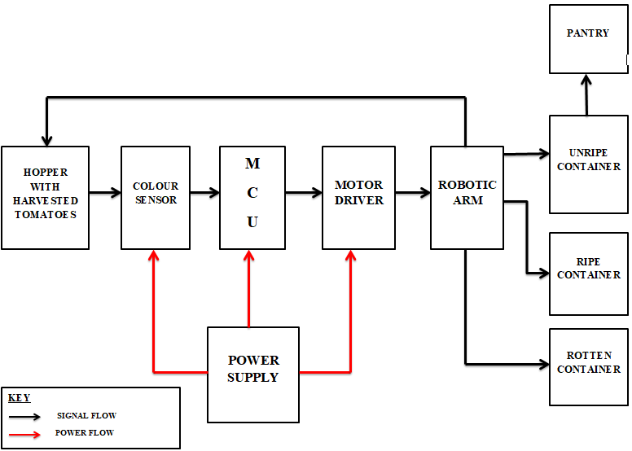
PROPOSED SYSTEM BLOCK DIAGRAM

Slide 10
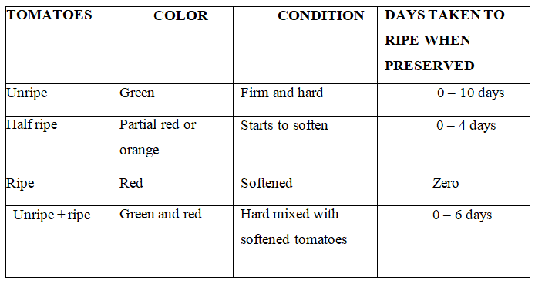
DATA COLLECTION.
PRIMARY DATA

Slide 11
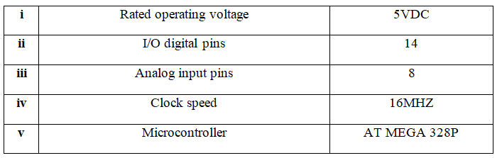
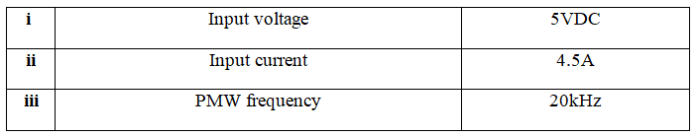
SECONDARY DATA
Microcontroller specifications.
Motor driver

Slide 12
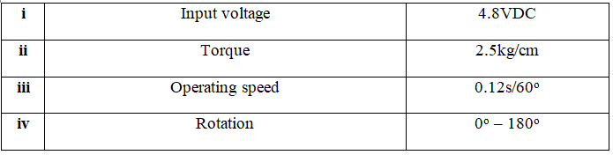

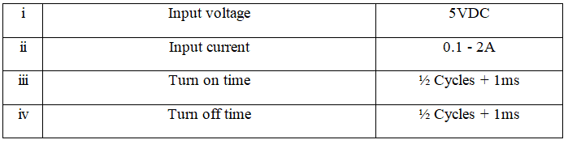
Servo motor
Relay

Slide 13
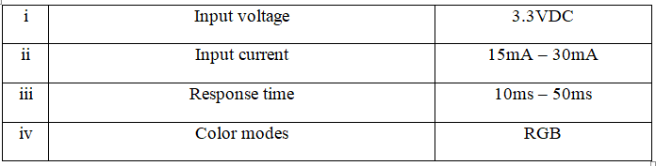
Color sensor

